Slide 1
2.3 Scheduling

Slide 2
Introduction to Scheduling (1)
Maximum CPU utilization obtained with multiprogramming
CPU–I/O Burst Cycle – Process execution consists of a cycle of CPU execution and I/O wait
CPU burst distribution

Slide 3
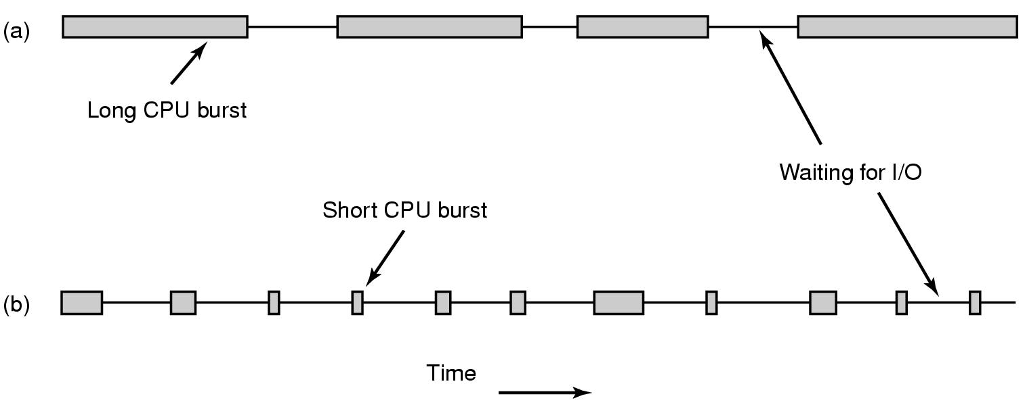
Introduction to Scheduling
Bursts of CPU usage alternate with periods of I/O wait
a CPU-bound process
an I/O bound process
The important thing to notice about Fig. above is that some processes, such as the one in (a), spend most of their time computing, while other processes, such as the one shown in (b), spend most of their time waiting for I/O

Slide 4
Optimization Scheduling Criteria
Max CPU utilization: keep the CPU as busy as possible.
Max throughput: maximize jobs per hour (batch systems)
Min turnaround time: minimize time between submission and termination (batch systems)
Min waiting time (amount of time a process has been waiting in the ready queue)
Min response time (amount of time it takes from when a request was submitted until the first response is produced)

Slide 5
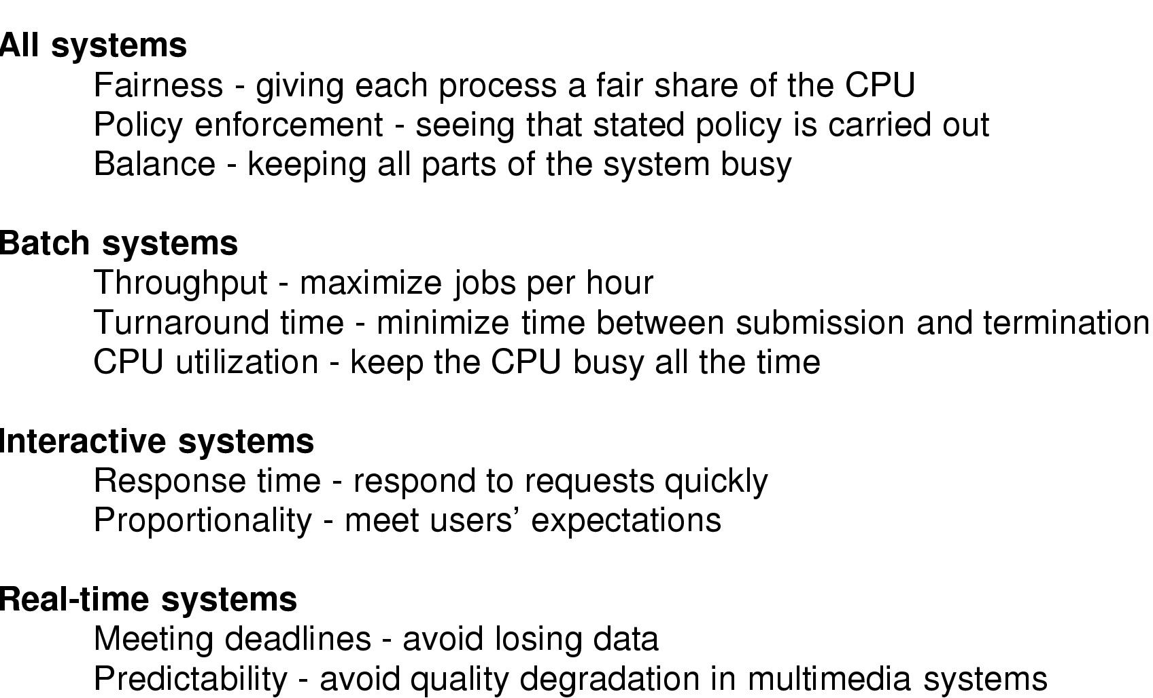
Scheduling Algorithm Goals

Slide 6
Scheduling in Batch Systems
First-Come, First-Served (FCFS) Scheduling
Process Burst Time
P₁ 24
P₂ 3
P₃ 3
Suppose that the processes arrive in the order: P₁ , P₂ , P₃ The Gantt Chart for the schedule is:
Waiting time for P₁ = 0; P₂ = 24; P₃ = 27
Average waiting time: (0 + 24 + 27)/3 = 17
P₁
P₂
P₃
0
24
27
30

Slide 7
Scheduling in Batch Systems (2)
FCFS Scheduling (Cont.)
Suppose that the processes arrive in the order
P₂ (3), P₃ (3), P₁ (24)
The Gantt chart for the schedule is:
Waiting time for P₁ = 6; P₂ = 0; P₃ = 3
Average waiting time: (6 + 0 + 3)/3 = 3
Much better than previous case
Convoy effect short process behind long process
P₂
P₃
P₁
0
3
6
30

Slide 8
Scheduling in Batch Systems (3)
Shortest-Job-First (SJF) Scheduling
Associate with each process the length of its next CPU burst. Use these lengths to schedule the process with the shortest time
Two schemes:
nonpreemptive – once CPU given to the process it cannot be preempted until completes its CPU burst
preemptive – if a new process arrives with CPU burst length less than remaining time of current executing process, preempt. This scheme is know as the Shortest-Remaining-Time-First (SRTF)
SJF is optimal – gives minimum average waiting time for a given set of processes
The only problem with this algorithm is that it is difficult to realize. how can the system tell which job is shortest? Still, by running a program on a simulator and keeping the burst time and use it for the second run of the program.

Slide 9
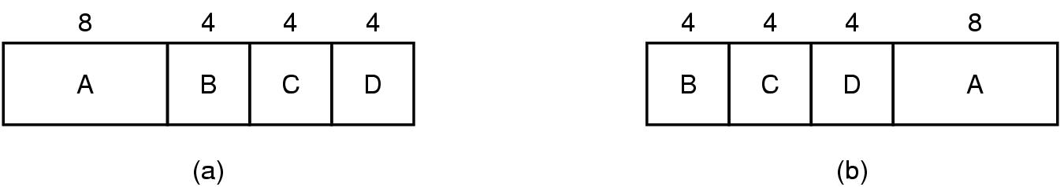
Scheduling in Batch Systems (4)
An example of shortest job first scheduling

Slide 10
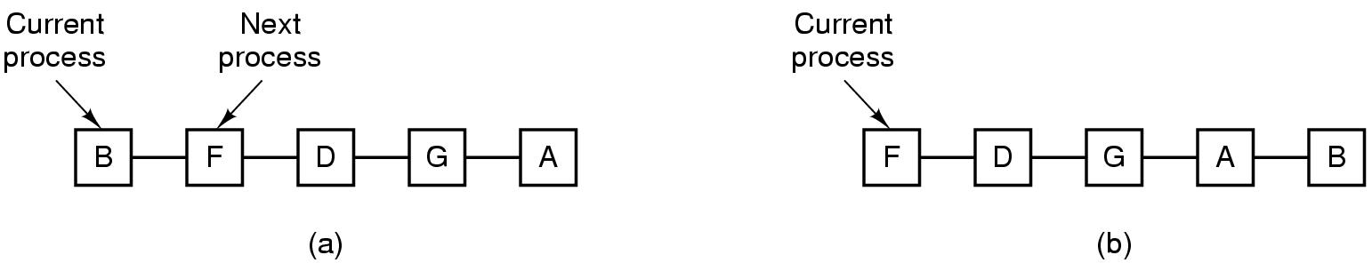
Scheduling in Interactive Systems (1)
Round Robin Scheduling
list of runnable processes (a)
list of runnable processes after B uses up its quantum (b)

Slide 11
Scheduling in Interactive Systems (2)
Round Robin Scheduling (cont.)`
Each process is assigned a time interval, called its quantum, during which it is allowed to run. If the process is still running at the end of the quantum, it is preempted and added to the end of the ready queue.
The only really interesting issue with round robin is the length of the quantum. Switching from one process to another requires a certain amount of time for doing all the administration called process switch. Suppose process takes 1 msec. Also suppose that the quantum is set at 4 msec. With these parameters, after doing 4 msec of useful work, the CPU will have to spend (i.e., waste) 1 msec on process switching. Thus 20% of the CPU time will be thrown away on administrative over-head. Clearly, this is too much.

Slide 12
Scheduling in Interactive Systems (3)
Round Robin Scheduling (cont.)`
To improve the CPU efficiency, we could set the quantum to, say, 100 msec. Now the wasted time is only 1%. But consider what happens on a server system if 50 requests come in within a very short time interval and with widely varying CPU requirements. Fifty processes will be put on the list of runnable processes. If the CPU is idle, the first one will start immediately, the second one may not start until 100 msec later, and so on.
The conclusion can be formulated as follows: setting the quantum too short causes too many process switches and lowers the CPU efficiency, but setting it too long may cause poor response to short interactive requests. A quantum around 20–50 msec is often a reasonable compromise.

Slide 13
Scheduling in Interactive Systems (4)
Example of RR with Time Quantum = 20
Process Burst Time
P₁ 53
P₂ 17
P₃ 68
P₄ 24
The Gantt chart is: Typically, higher average turnaround than SJF, but better response
P₁
P₂
P₃
P₄
P₁
P₃
P₄
P₁
P₃
P₃
0
20
37
57
77
97
117
121
134
154
162

Slide 14
Scheduling in Interactive Systems (5)
Priority Scheduling: A priority number (integer) is associated with each process. The process with the highest priority is served first.
Problem ≡ Starvation – low priority processes may never execute
Solution ≡ Aging – as time progresses increase the priority of the process

Slide 15
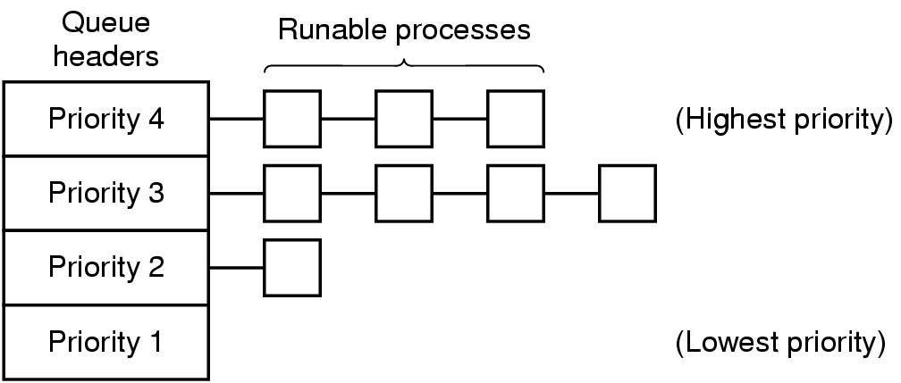
Scheduling in Interactive Systems (6)
A scheduling algorithm with four priority classes

Slide 16
Scheduling in Real-Time Systems (1)
Hard real-time systems – required to complete a critical task within a guaranteed amount of time
Soft real-time computing – requires that critical processes receive priority over less fortunate ones

Slide 17
Scheduling in Real-Time Systems (2)
A real-time system is one in which time plays an essential role. For example, the computer in a compact disc player gets the bits as they come off the drive and must convert them into music within a very tight time interval. If the calculation takes too long, the music will sound peculiar. Other real-time systems are patient monitoring in a hospital intensive-care unit, the autopilot in an aircraft, and robot control in an automated factory. In all these cases, having the right answer but having it too late is often just as bad as not having it at all.
Real-time systems are generally categorized as hard real time, meaning there are absolute deadlines that must be met; and soft real time, meaning that missing an occasional deadline is undesirable, but nevertheless tolerable. In both cases, real-time behavior is achieved by dividing the program into a number of processes, each of whose behavior is predictable and known in advance. These processes are generally short lived and can run to completion in well under a second. When an external event is detected, it is the job of the scheduler to schedule the processes in such a way that all deadlines are met.

Slide 18
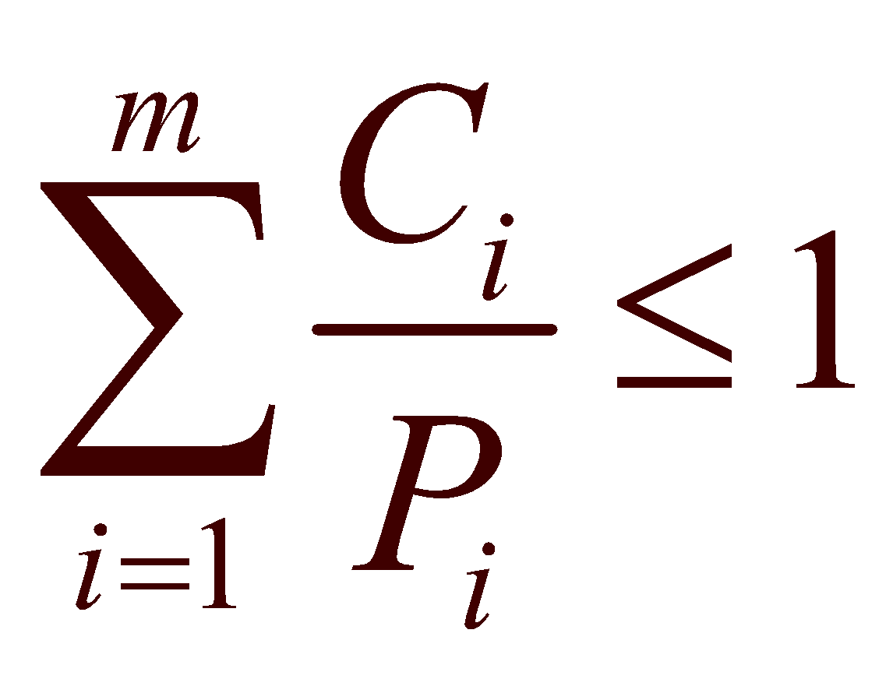
Scheduling in Real-Time Systems (3)
The events that a real-time system may have to respond to can be further categorized as periodic (meaning they occur at regular intervals) or aperiodic (meaning they occur unpredictably). A system may have to respond to multiple periodic-event streams. Depending on how much time each event requires for processing, handling all of them may not even be possible. For example, if there are m periodic events and event i occurs with period Pi and requires Ci sec of CPU time to handle each event, then the load can be handled only if
A real-time system that meets this criterion is said to be schedulable. This means it can actually be implemented. A process that fails to meet this test cannot be scheduled because the total amount of CPU time the processes want collectively is more than the CPU can deliver.
As an example, consider a soft real-time system with three periodic events, with periods of 100, 200, and 500 msec, respectively. If these events require 50, 30, and 100 msec of CPU time per event, respectively, the system is schedulable because 0. 5 + 0. 15 + 0. 2 < 1.

Slide 19
Thread Scheduling (1)
Local Scheduling – How the threads library decides which thread to put onto an available
Global Scheduling – How the kernel decides which kernel thread to run next

Slide 20
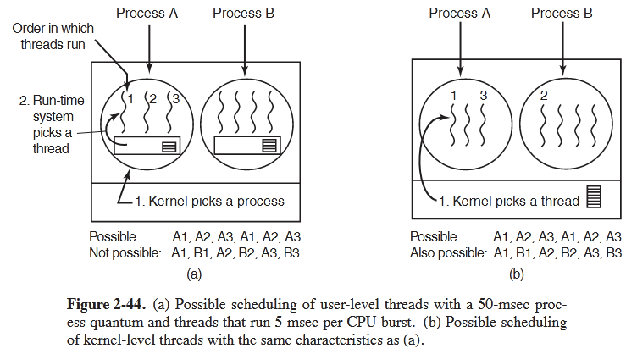
Thread Scheduling (2)

